Slide 1
FINAL ASSEMBLY QA AREA
ETHANOL FUMES EXTRACTION PROJECT

Slide 2
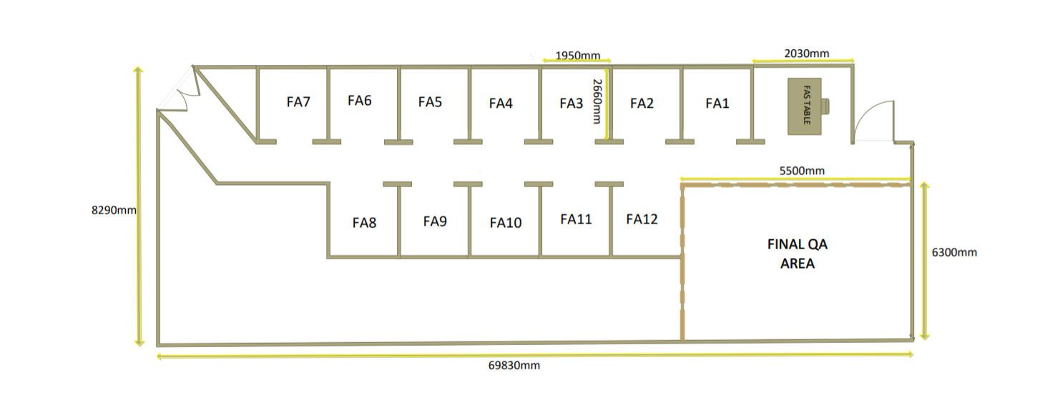
FINAL ASSEMBLY LAYOUT DIMENSIONS
FULL AREA A= LXW = 8.29 X 6.983 = 57.88 m2
Q.A AREA A= LXW = 6.30 X 5.5 = 34.65 m2

Slide 3

BENEFITS VS DANGERS OF INSTALLING FUMES

Slide 4
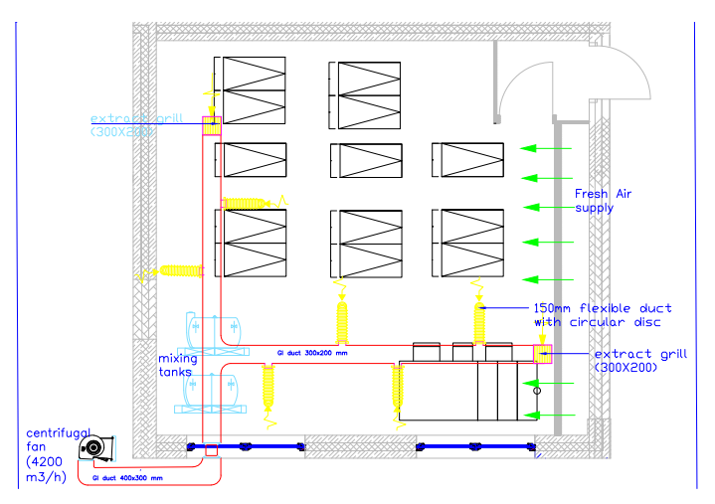
GILFIAN:DRAWING PROPOSAL

Slide 5
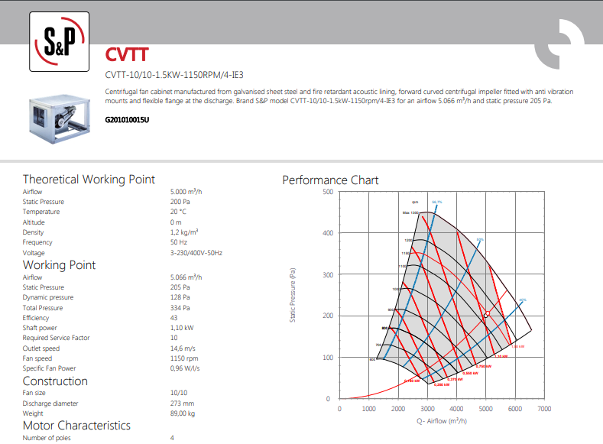

Slide 6
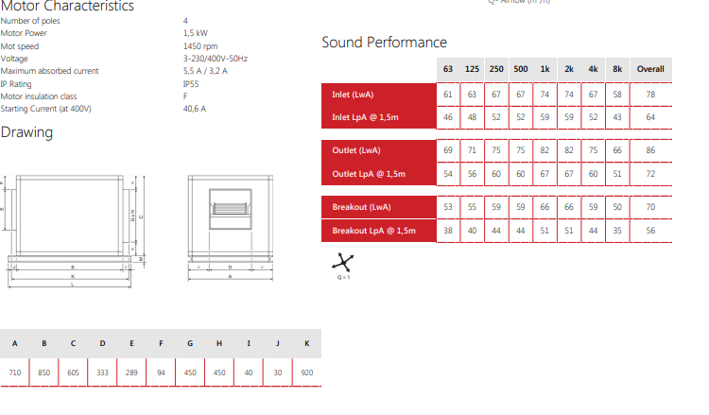

Slide 7
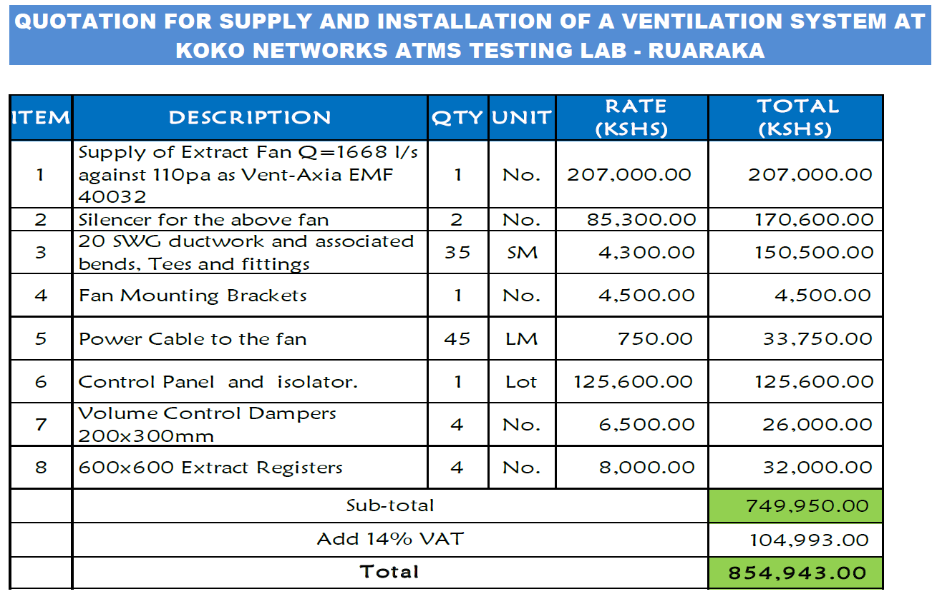
GILFIAN IST QUOTE PRICE

Slide 8
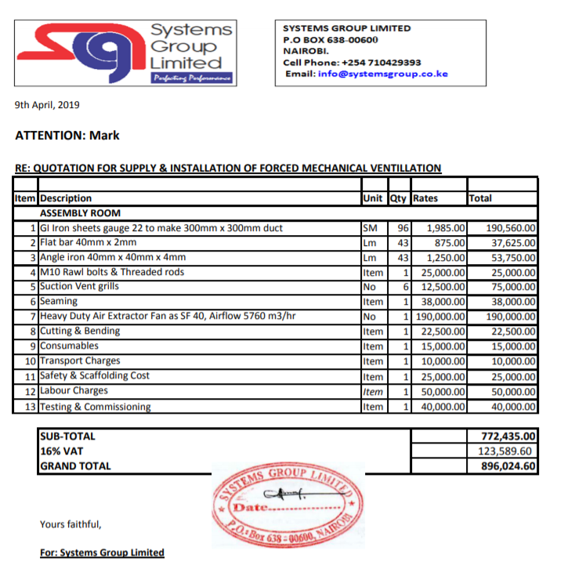
SYSTEMS GROUP 1ST QUOTE PRICE

Slide 9
COMPARISON QUOTES MATRIX
Criteria | GILFIAN | SYSTEM GROUP | OTHER SUPPLIERS (PROCUREMENT TO PROVIDE)
1st Quote Price | Ksh 484,779 | Ksh 893,495
2nd Quote Price after Revision | Procurement can engage | KSh 753,338
Fan Speed / Capacity/Specs Provided | 4200 - 5000 m3/hr 1150 -1450 Rpm Motor 1.5 Kw Motor Power,SS Type,IP55 (See Details)
Choice / Recommendations | Better price,Details Provided,Affordable long lasting choice of material | High cost price,Details and video provided with procurement

Slide 10
OTHER NOTES
The fan will be installed on the roof top thus no noise and can withstand all weather conditions
IP55. Water projected by a nozzle against the enclosure from any direction shall have no harmful to the motor drive
The IP Code reflects the degree of protection as "IP" followed by two numbers; the first digit shows the extent to which enclosures are protected against particles, and protection to others from enclosed hazards. The second digit indicates the extent of protection against water. We carry IP55 enclosures that demonstrate almost complete protection from particles and a good level of protection against water

